Slide 1
A Data science Project on
“Ratings Prediction”
Submitted by: Santosh Arvind Dharam

Slide 2
Problem Statement
We have to build an application which can predict the rating by seeing the review.

Slide 3
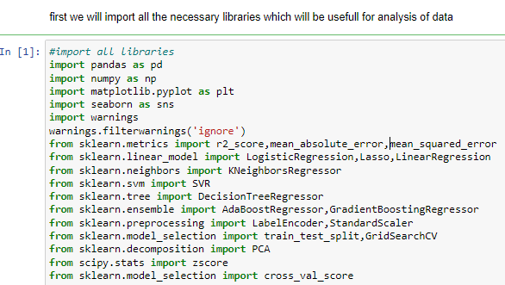
EDA steps step-1(import necessary libraries)

Slide 4
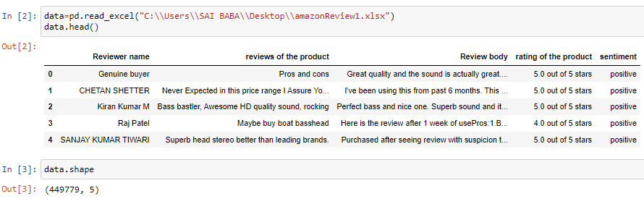
Step-2(extract the dataset in jupyter notebook) Data is extracted for further analysis in jupyter notebook

Slide 5
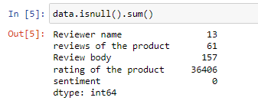
Step-3(checking null values)

Slide 6
In this case we have to find out the null values present in our data set. if it is there it is required to remove it. in our data set has some null values which is shown

Slide 7
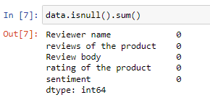
Removing Null Values
Null values which are present in the dataset is removed by the mode function

Slide 8
Data Encoding
It is necessary to encode the data as the data contains object type of data , so it is need to convert into the integer type for the further analysis. it is possible with the help of LabelEncoder

Slide 9
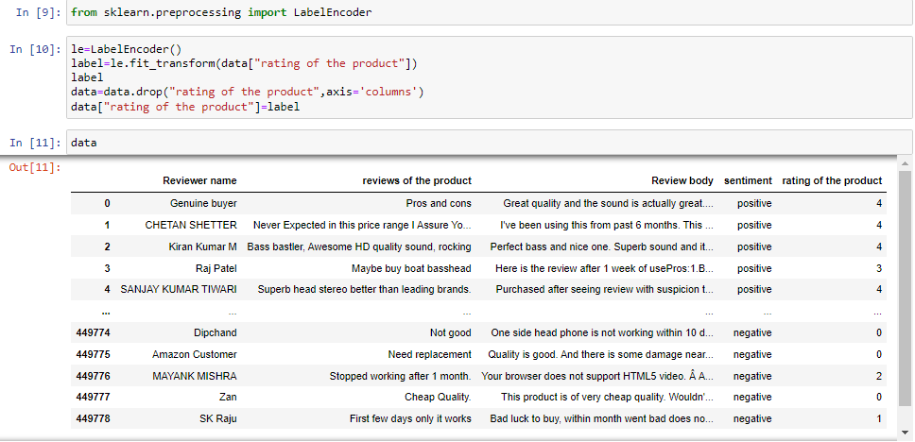

Slide 10
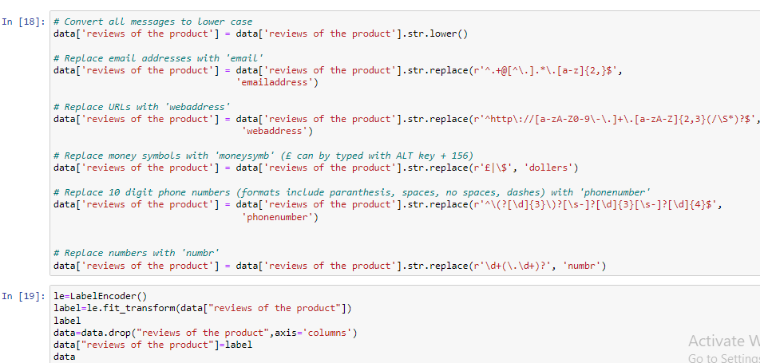

Slide 11
Also in the column of ‘reviews of the product’ it contains data in mix form so it is need to convert into the integer form that can be done by doing some steps as above.

Slide 12
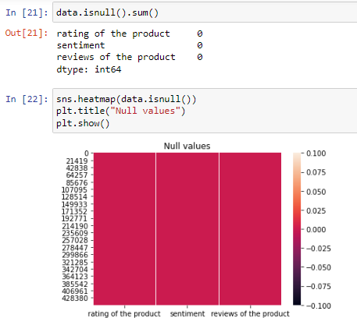
heat map
So all the null values are removed now ,it is also shown by the heat map as above

Slide 13
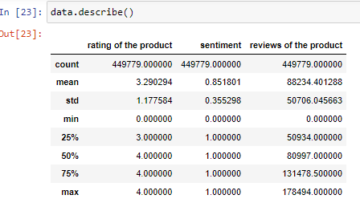
Data Description
It gives the detail description of data with total counts ,mean with its std deviation also it gives mini to maximum values present in that particular column as the value of std deviation is less as compare to mean ,it shows that our data is well for further analysis.

Slide 14
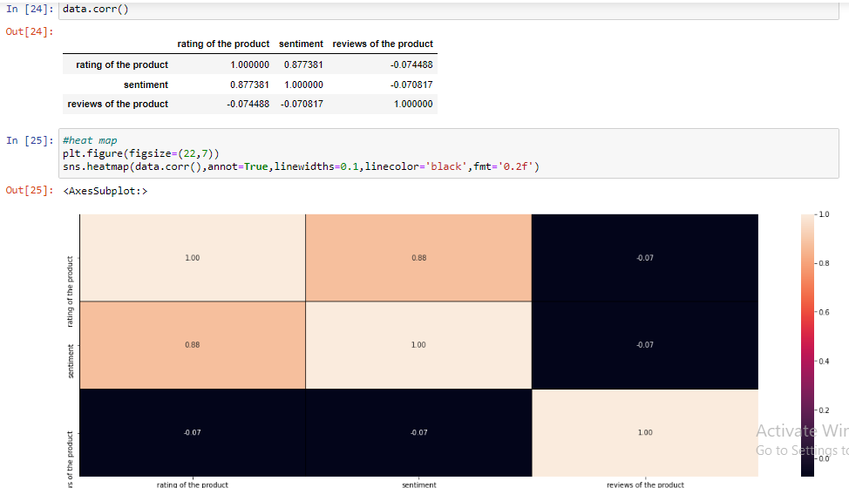
Data correlation
It gives the correlation of targe variable with the other column ,it also gives positive negative correlation of each column .

Slide 15
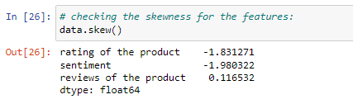
Finding and Removing the Skewness
it shows that there is no skewness present in our dataset

Slide 16
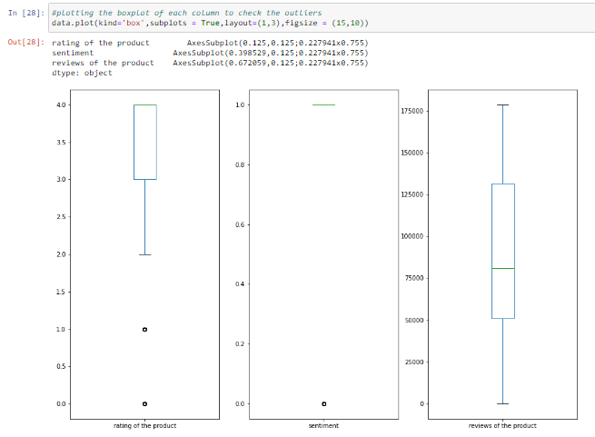
checking outliers

Slide 17
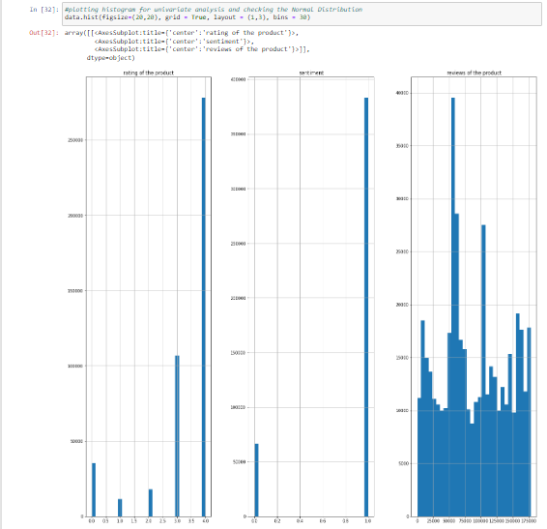
plotting of histogram
It shows that data is uniformly distributed in each column

Slide 18
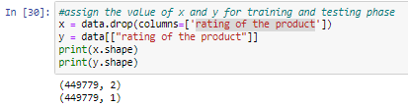
Divide data into x and y variable

Slide 19
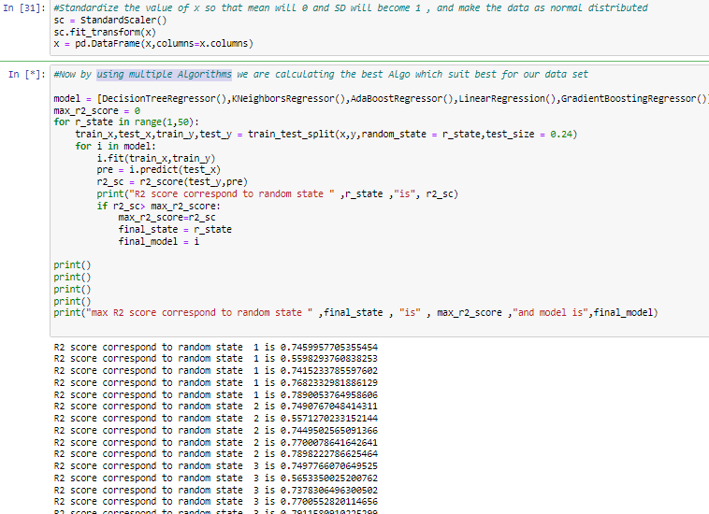
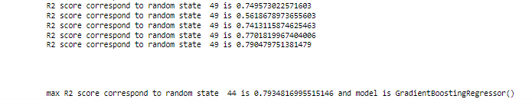
using multiple Algorithms

Slide 20
So we got maximum R2score for random state of 44 is 79.34% foe model of GradientBoostingRegressor()

Slide 21
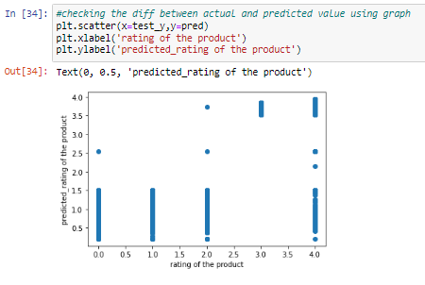
Scatter Plot
It gives the actual vs predicted rating of product ,they are very close to each other

Slide 22
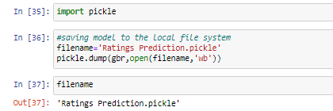
Saving Model
We have saved the model with the file name as ratings prediction.

Slide 23
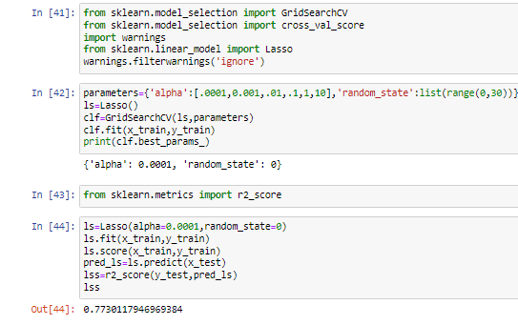
Hyper parameter Tuning
So by doing the hyper parameter tuning we got alpha as 0.0001 with random state of 0, from this we got r2 score as 77.30%.

Slide 24
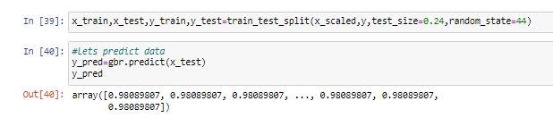
conclusion
We observed that data was not filled with outliers also there some encoding is done now data is uniformly distributed in column. it is also observed from subplot, we have saved model and also predicted the result with help of saved model .model is ready for the future data prediction

